Slide 1
Socket UDP

Slide 2
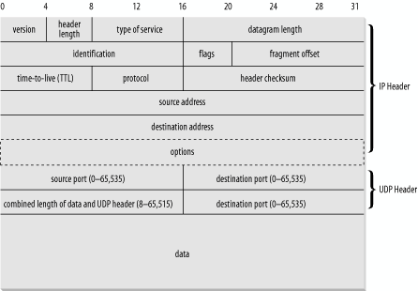
UDP

Slide 3
Socket programming with UDP
UDP: no “connection” between client and server
no handshaking
sender explicitly attaches IP address and port of destination to each segment
OS attaches IP address and port of sending socket to each segment
Server can extract IP address, port of sender from received segment
application viewpoint
UDP provides unreliable transfer
of groups of bytes (“datagrams”)
between client and server
Note: the official terminology
for a UDP packet is “datagram”. In this class, we instead use “UDP segment”.

Slide 4
Running example
Client:
User types line of text
Client program sends line to server
Server:
Server receives line of text
Capitalizes all the letters
Sends modified line to client
Client:
Receives line of text
Displays

Slide 5
Client/server socket interaction: UDP
Server (running on hostid)
Client
create socket,
port= x.
create socket,
clientSocket =
DatagramSocket()
serverSocket =
DatagramSocket()
Create datagram with server IP and
port=x; send datagram via clientSocket
read datagram from
serverSocket
write reply to
serverSocket
specifying client address,
port number
read datagram from
clientSocket
close
clientSocket

Slide 6
Example: Java client (UDP)
Client
process
Input: receives packet (recall thatTCP received “byte stream”)
Output: sends packet (recall
that TCP sent “byte stream”)
client UDP socket

Slide 7
Example: Java client (UDP)
import java.io.*;
import java.net.*;
class UDPClient {
public static void main(String args[]) throws Exception
{
BufferedReader inFromUser =
new BufferedReader(new InputStreamReader(System.in));
DatagramSocket clientSocket = new DatagramSocket();
InetAddress IPAddress = InetAddress.getByName("hostname");
byte[] sendData = new byte[1024];
byte[] receiveData = new byte[1024];
String sentence = inFromUser.readLine();
sendData = sentence.getBytes();
Create
input stream
Create
client socket
Translate
hostname to IP
address using DNS

Slide 8
Example: Java client (UDP), cont.
Create datagram with data-to-send,
length, IP addr, port
DatagramPacket sendPacket =
new DatagramPacket(sendData, sendData.length, IPAddress, 9876);
clientSocket.send(sendPacket);
DatagramPacket receivePacket =
new DatagramPacket(receiveData, receiveData.length);
clientSocket.receive(receivePacket);
String modifiedSentence =
new String(receivePacket.getData());
System.out.println("FROM SERVER:" + modifiedSentence);
clientSocket.close();
}
}
Send datagram
to server
Read datagram
from server

Slide 9
Example: Java server (UDP)
import java.io.*;
import java.net.*;
class UDPServer {
public static void main(String args[]) throws Exception
{
DatagramSocket serverSocket = new DatagramSocket(9876);
byte[] receiveData = new byte[1024];
byte[] sendData = new byte[1024];
while(true)
{
DatagramPacket receivePacket =
new DatagramPacket(receiveData, receiveData.length);
serverSocket.receive(receivePacket);
Create
datagram socket
at port 9876
Create space for
received datagram
Receive
datagram

Slide 10
Example: Java server (UDP), cont
String sentence = new String(receivePacket.getData());
InetAddress IPAddress = receivePacket.getAddress();
int port = receivePacket.getPort();
String capitalizedSentence = sentence.toUpperCase();
sendData = capitalizedSentence.getBytes();
DatagramPacket sendPacket =
new DatagramPacket(sendData, sendData.length, IPAddress,
port);
serverSocket.send(sendPacket);
}
}
}
Get IP addr
port #, of
sender
Create datagram
to send to client
Write out
datagram
to socket
End of while loop,
loop back and wait for
another datagram

